Slide 1

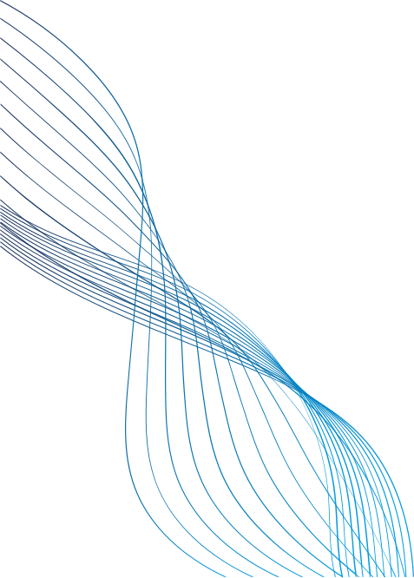

CRYPTO VOLATILITY AND RISK ANALYZER

Slide 2

TEAM INTRO
MENTOR: S.SOPHIYA
TEAM MEMBERS:
1. RAMA LAKSHMI KALLA
2. ASHUTOSH CHOUDHURY
3. KALASHREE KALPANA
4. CHARITHA SRI NAGALLA
5. BADAM NAGASHREE

Slide 3
INTRODUCTION
Cryptocurrency markets are known for their high price fluctuations and volatility.
Prices of digital assets such as Bitcoin and Ethereum can change rapidly within a short period.
Understanding these fluctuations is important for investors and traders to make better financial decisions.
This project analyzes cryptocurrency data and visualizes volatility patterns to help understand the risk involved.

Slide 4

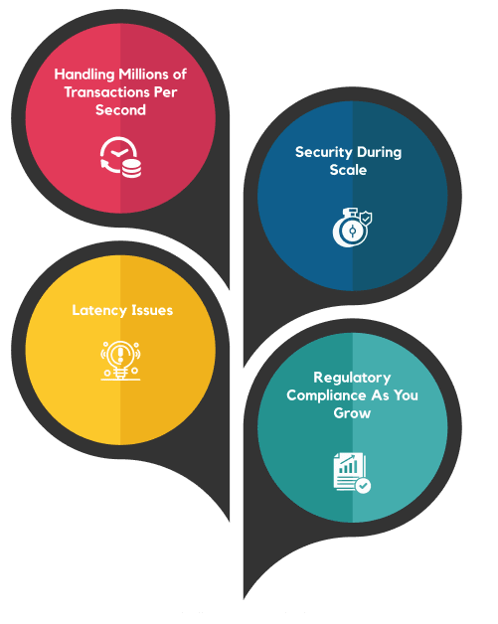
PROBLEM STATEMENT
CRYPTOCURRENCY MARKETS ARE HIGHLY UNPREDICTABLE AND VOLATILE.
MANY INVESTORS STRUGGLE TO EVALUATE THE RISK LEVEL OF DIFFERENT CRYPTOCURRENCIES BEFORE INVESTING.
THERE IS A NEED FOR A SYSTEM THAT CAN ANALYZE CRYPTO PRICE DATA, CALCULATE RISK METRICS, AND PRESENT INSIGHTS VISUALLY TO SUPPORT INFORMED INVESTMENT DECISIONS.

Slide 5
PROJECT OBJECTIVES
DATA ANALYSIS
Analyze cryptocurrency price data to understand market trends and volatility patterns.
Calculate financial risk metrics such as volatility, Sharpe ratio, and beta coefficient to measure the risk level of cryptocurrencies.
RISK EVALUATION
Present insights through interactive dashboards and charts to help users easily compare and understand crypto risk levels.
DATA VISUALIZATION

Slide 6
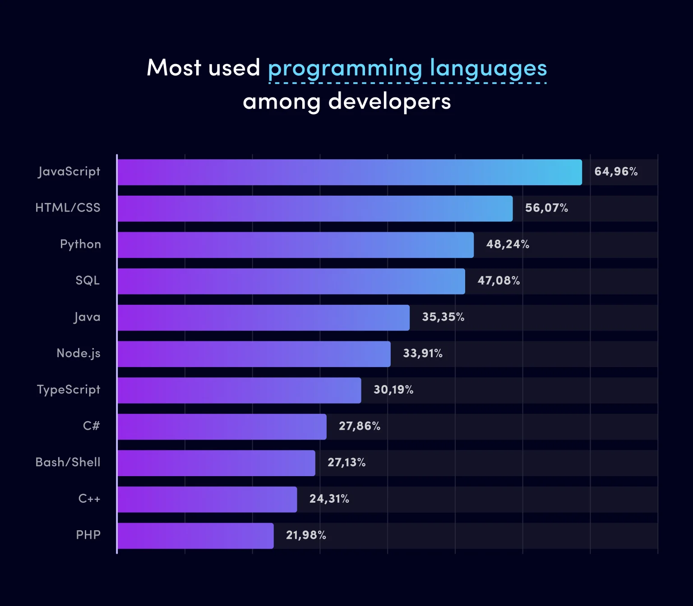
TECHNOLOGIES USED
THE PROJECT USES THE FOLLOWING TECHNOLOGIES:
Python – main programming language
Pandas & NumPy – data processing and analysis
Plotly / Matplotlib – data visualization
Streamlit – interactive dashboard development
CoinGecko / Binance API – cryptocurrency data fetching

Slide 7





SYSTEM ARCHITECTURE / WORKFLOW
Data Collection
Cryptocurrency price data is fetched from APIs such as CoinGecko or Binance.
Data Processing
The collected data is cleaned and processed for analysis.
Risk Analysis
Financial metrics like volatility, Sharpe ratio, and beta are calculated.
Visualization
Interactive charts and graphs are created to display insights.
Risk Classification
Cryptocurrencies are categorized based on their risk levels.

Slide 8
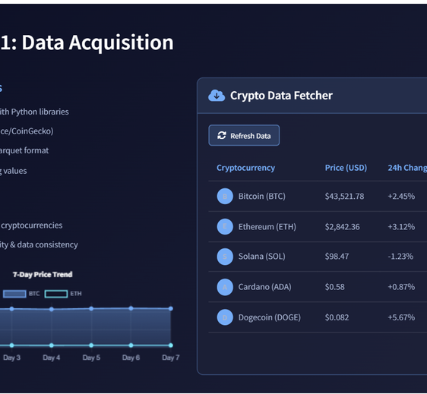
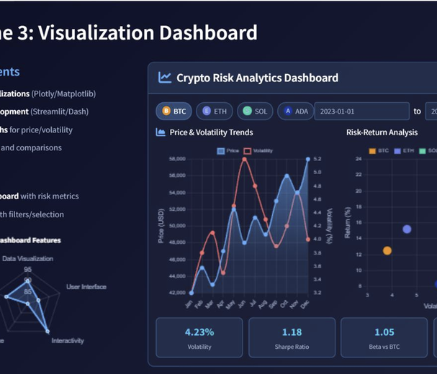
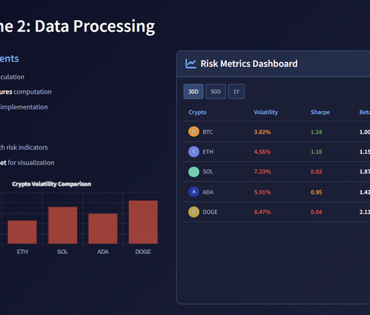
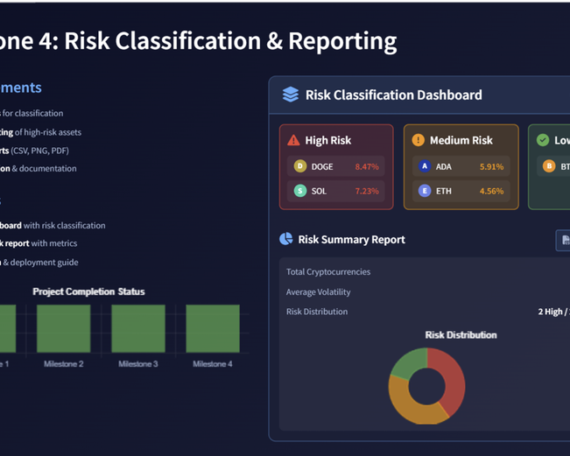
MODULES OF THE SYSTEM
1. Data Acquisition Module
3. Visualization Module
Fetches live and historical cryptocurrency data from APIs.
Stores the data for further analysis.
Creates graphs and charts to display trends and patterns.
2. Data Processing Module
4. Risk Classification & Reporting Module
Calculates daily returns and statistical measures.
Processes data for volatility and risk analysis.
Classifies cryptocurrencies based on calculated risk metrics.
Generates summarized reports.

Slide 9
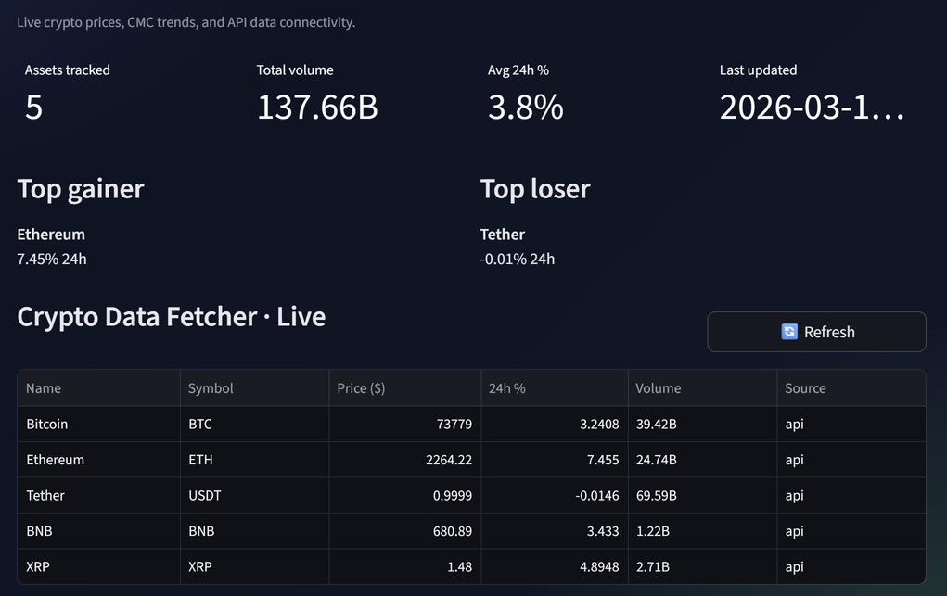
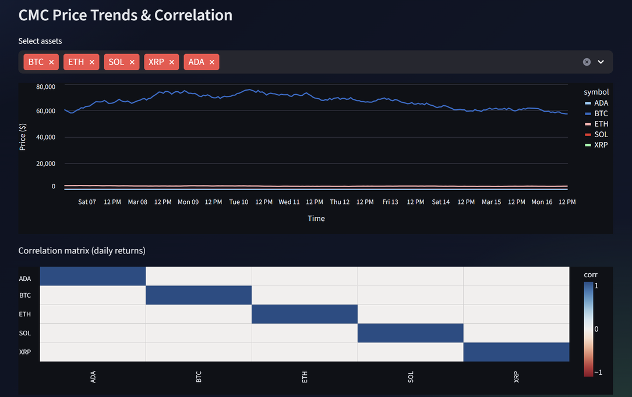
MODULE 1 – DATA ACQUISITION & SETUP
REQUIREMENTS
Set up the project environment with required libraries (Pandas, NumPy, Requests, Plotly, Dash).
Integrate cryptocurrency APIs (Binance/CoinGecko) to fetch price data.
Store the data in CSV format for analysis.
Perform basic preprocessing, including handling missing values and formatting time-series data.
OUTPUT
Successfully collected and stored daily price data for at least 5 cryptocurrencies (BTC, ETH, SOL, ADA, DOGE).
Confirmed API connectivity and data consistency for reliable analysis.

Slide 10
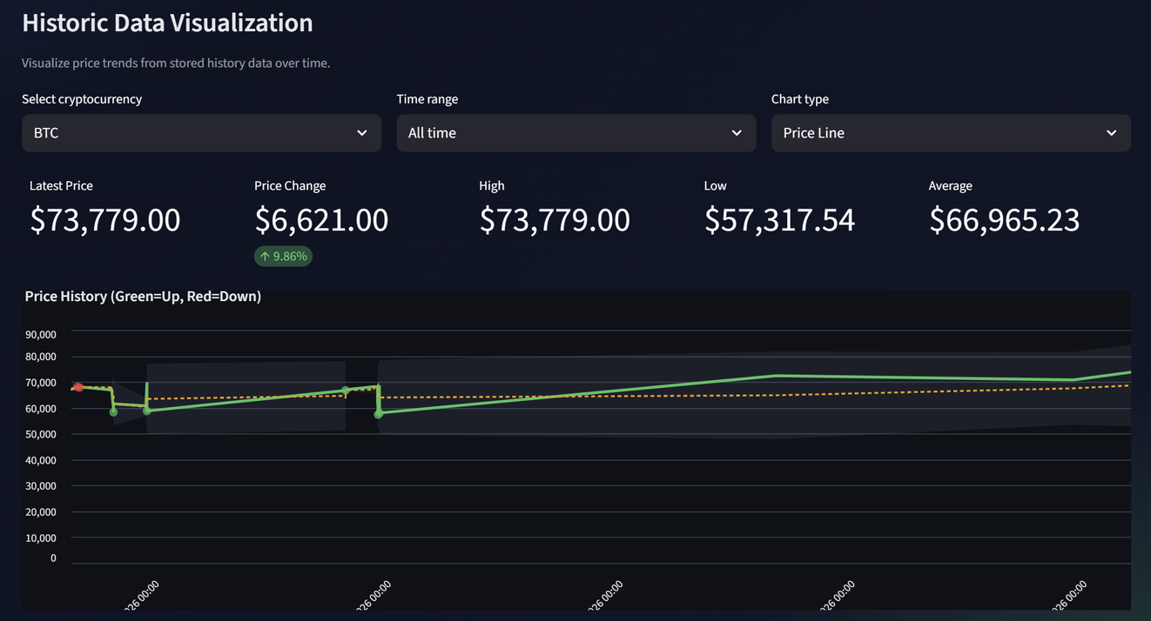
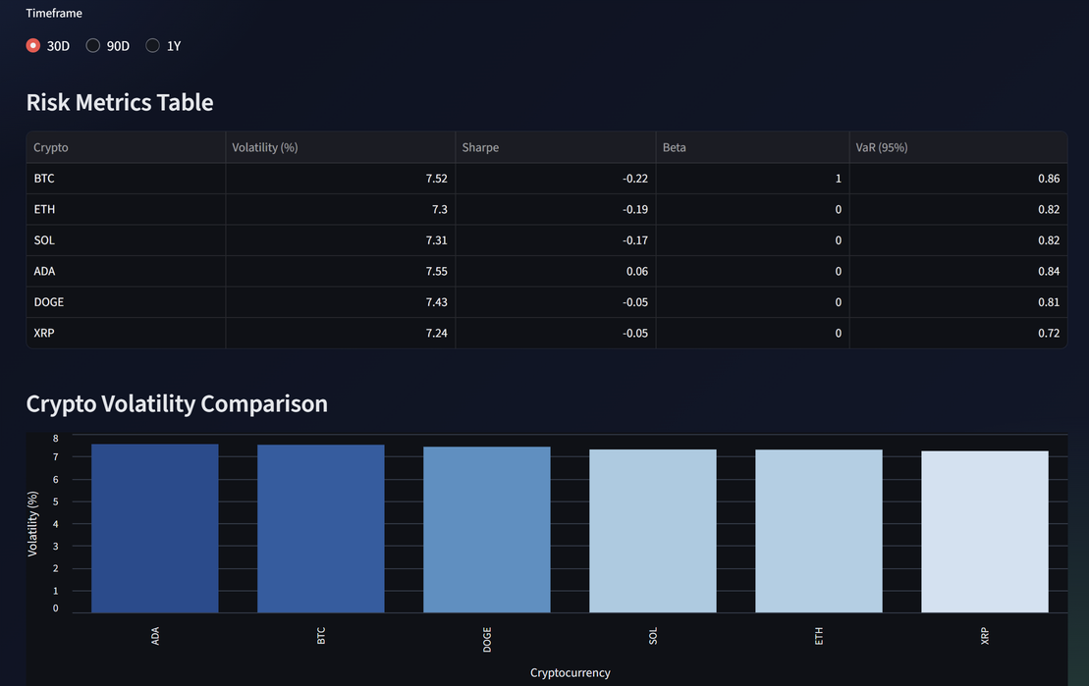
MODULE 2 – DATA PROCESSING & CALCULATION
REQUIREMENTS
OUTPUT
Calculate daily returns using log-return formulas.
Compute statistical measures such as:
Daily and Annualized Volatility
Sharpe Ratio and Beta Coefficient
Apply moving average and rolling window analysis to track volatility over time.
Generated a metrics table containing volatility, Sharpe ratio, and beta values for selected cryptocurrencies.
Prepared a processed dataset ready for visualization and risk classification.

Slide 11
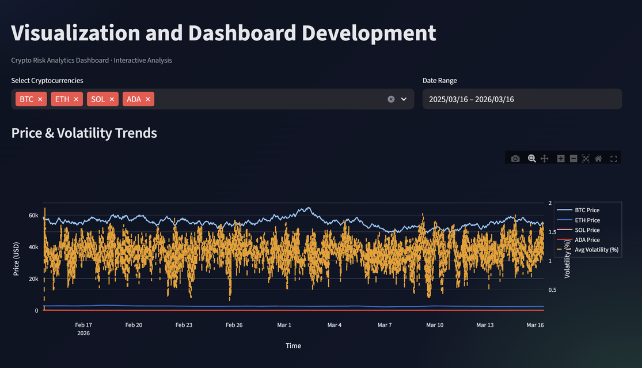
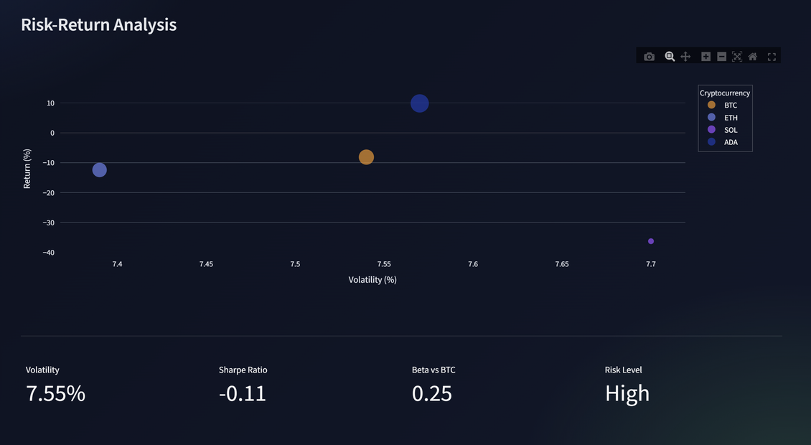
MODULE 3 – VISUALIZATION & DASHBOARD DEVELOPMENT
REQUIREMENTS
Create interactive visualizations using Plotly or Matplotlib.
Develop a dashboard (Streamlit/Dash) to display time-series price and volatility graphs, risk–return scatter plots, and enable comparison and filtering of cryptocurrencies.
OUTPUT
Developed an interactive dashboard showing volatility and Sharpe ratio for different cryptocurrencies.
Built a responsive interface that allows users to select date ranges and compare assets easily.

Slide 12
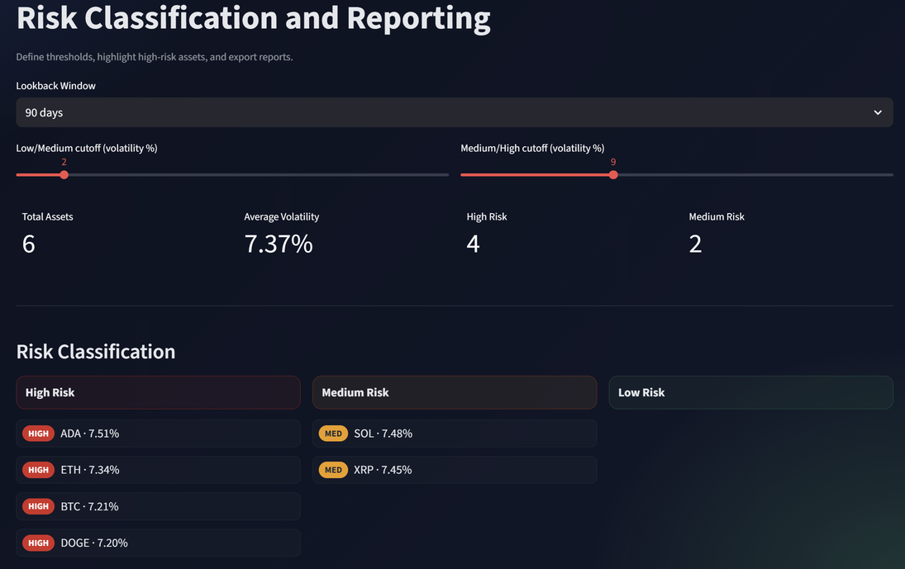
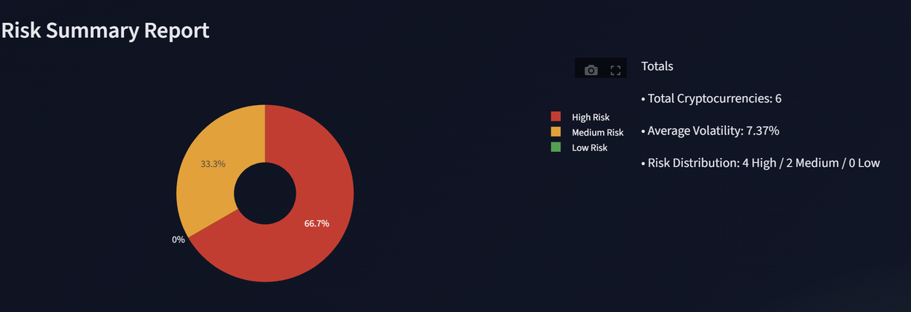

MODULE 4 – RISK CLASSIFICATION & REPORTING
REQUIREMENTS
DEFINE THRESHOLDS TO CLASSIFY CRYPTOCURRENCIES INTO LOW RISK, MEDIUM RISK, AND HIGH RISK.
VISUALLY HIGHLIGHT HIGH-RISK ASSETS IN THE DASHBOARD.
GENERATE SUMMARY REPORTS IN FORMATS SUCH AS CSV OR PNG.
VALIDATE SYSTEM PERFORMANCE AND COMPLETE PROJECT DOCUMENTATION.
OUTPUT
COMPLETED CRYPTO VOLATILITY AND RISK ANALYZER DASHBOARD.
Generated a final risk report showing volatility levels and Sharpe ratios for each cryptocurrency.

Slide 13

RESULTS
The Final system produces:
INTERACTIVE DASHBOARDS DISPLAYING CRYPTOCURRENCY PRICE TRENDS AND VOLATILITY.
RISK ANALYSIS METRICS FOR DIFFERENT CRYPTOCURRENCIES.
CLASSIFICATION OF CRYPTOCURRENCIES INTO:
LOW RISK
MEDIUM RISK
HIGH RISK
THESE INSIGHTS HELP INVESTORS BETTER UNDERSTAND MARKET RISK AND POTENTIAL RETURNS.

Slide 14





FUTURE ENHANCEMENTS
The project can be improved with additional features such as:
AI-based cryptocurrency price prediction models.
Portfolio optimization tools for better investment strategies.
Real-time alerts for sudden market volatility.
Integration with more cryptocurrency exchanges.

Slide 15
CONCLUSION
The Crypto Volatility and Risk Analyzer helps analyze cryptocurrency markets using data analytics techniques.
By calculating risk metrics and visualizing insights through dashboards, the system helps investors understand volatility and make informed decisions.
This project demonstrates how data science and visualization can be applied in financial market analysis.

Slide 16
THANK YOU
We welcome any questions or suggestions.

